Slide 1
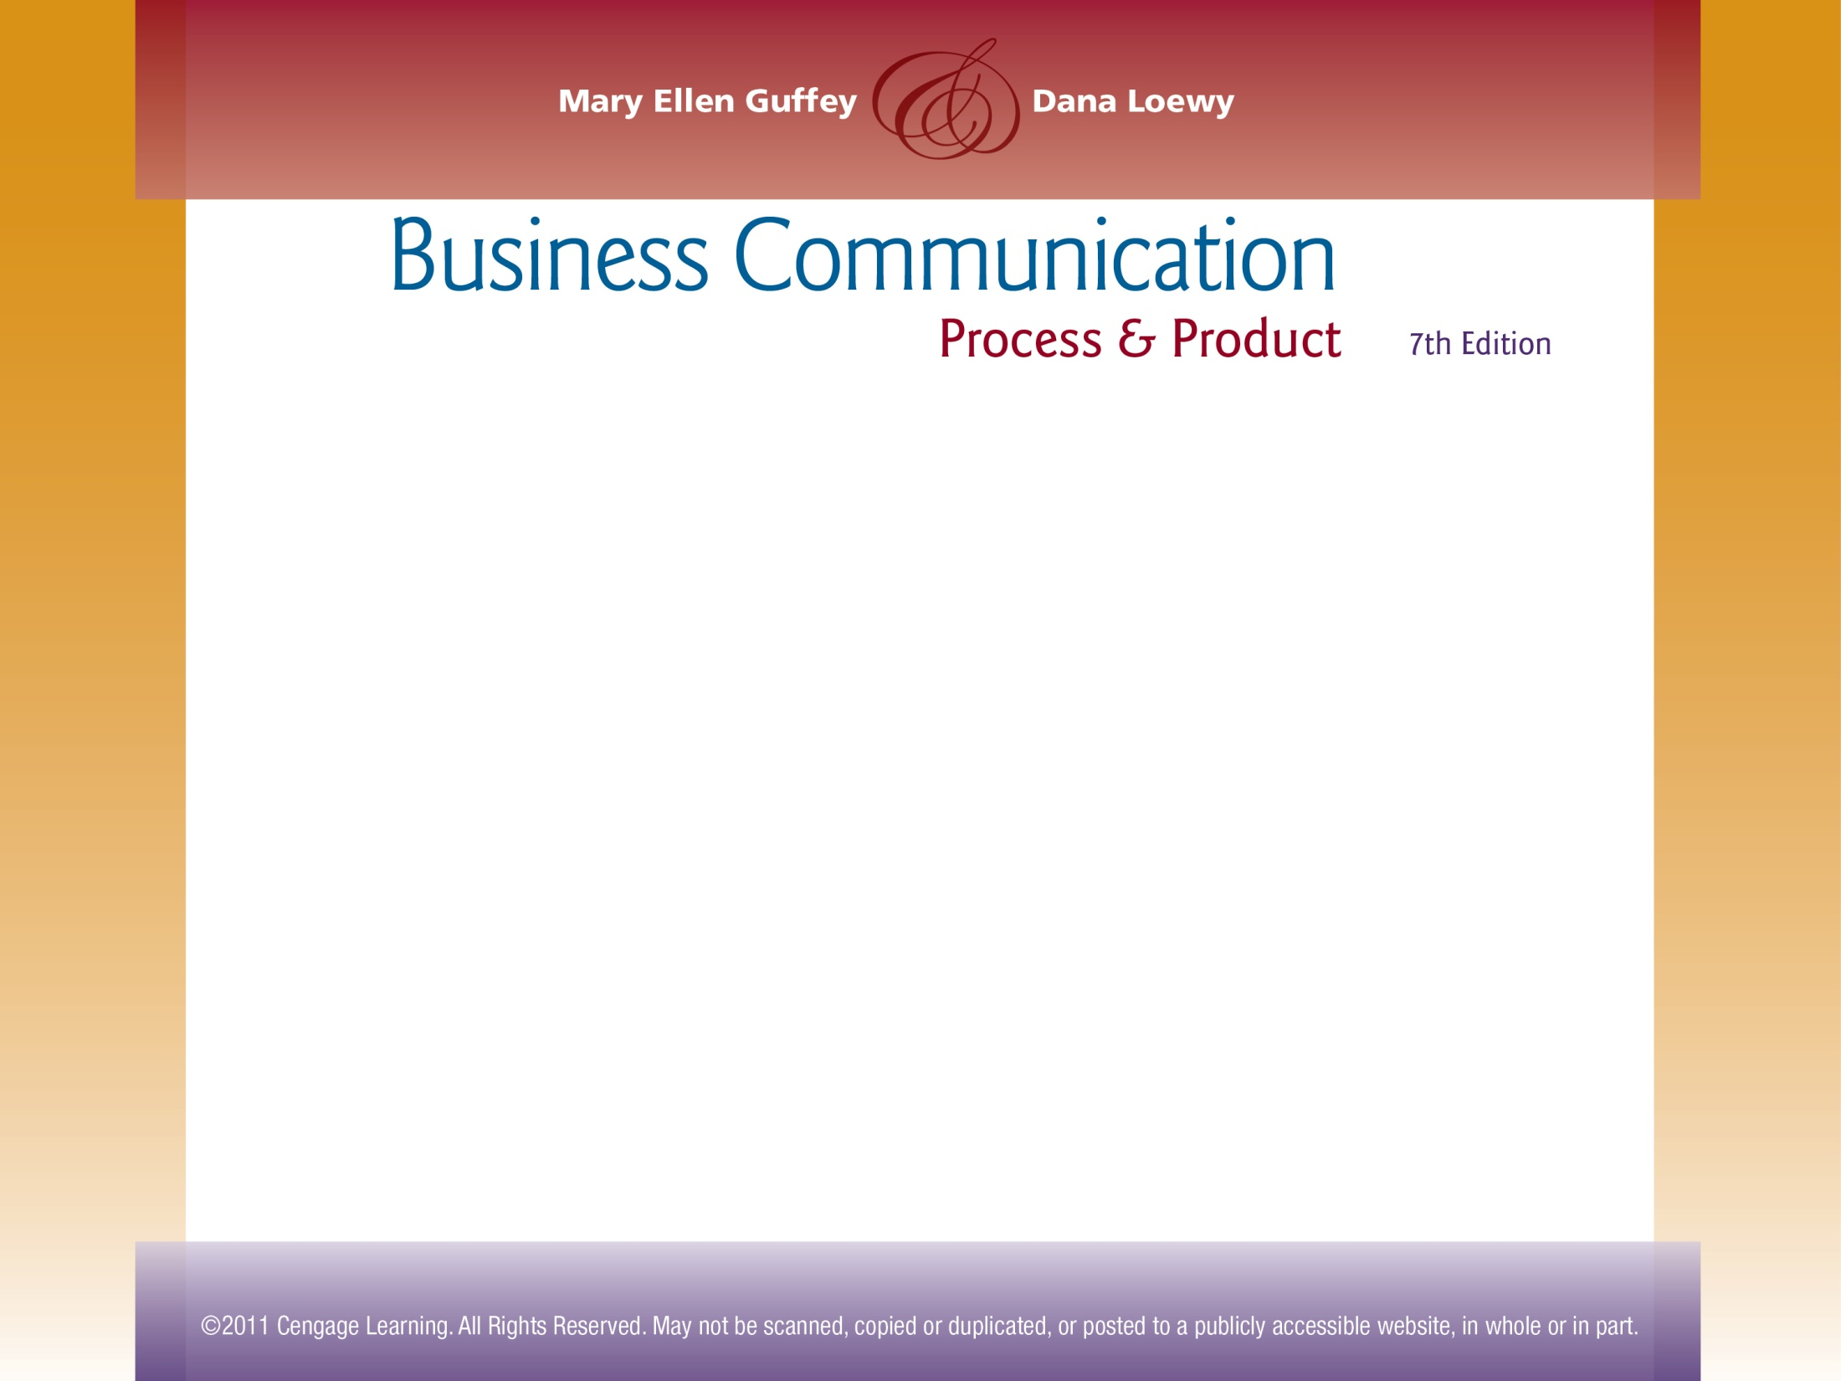

Chapter 7
Electronic Messages and Digital Media

Slide 2
Topics in This Chapter
Preparing and Composing Professional E-Mail Messages
Formatting E-Mail Messages
Smart E-Mail Practices
The Top Ten E-Mail Mistakes
Using Instant Messaging and Texting Professionally

Slide 3
Topics in This Chapter
Creating a Podcast (or Webcast) for Business
Creating a Professional Blog
Uses of Wikis in Business
How Businesses Use Social Networks
Really Simple Syndication and Social Bookmarking Sites

Slide 4

How Organizations Exchange Messages and Information
Paper-based messages
Business letters
Interoffice memos
Electronic messages
E-mail
Instant messaging
Text messaging
Podcasts
Blogs
Wikis
Social networking

Slide 5
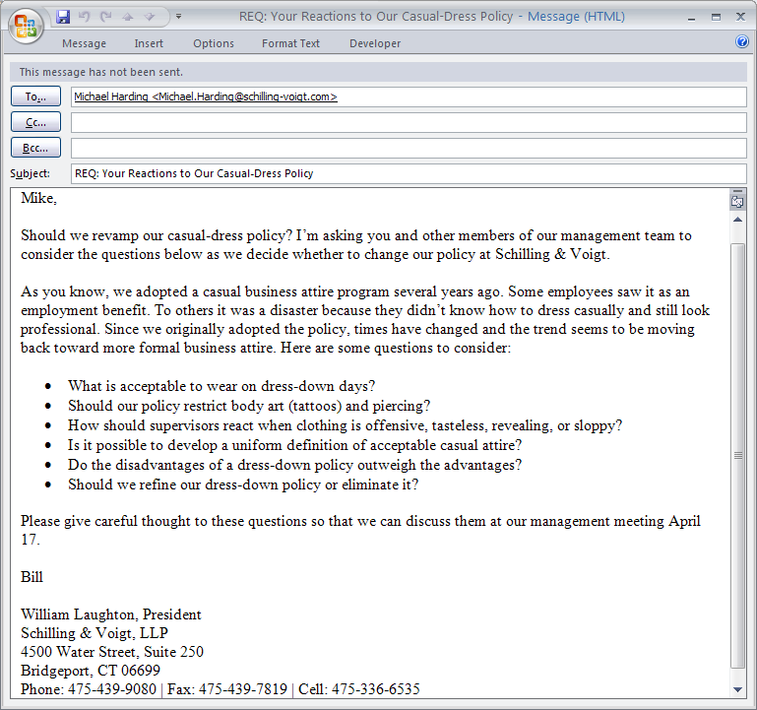
Preparing and Composing Professional E-Mail Messages
Summarizes main idea and uses REQ to remind receiver that a response is required
Opens with receiver’s name to express friendliness and to mark beginning of message
Starts directly, amplifies the main idea
Explains and discusses the topic

Slide 6
Preparing and Composing Professional E-Mail Messages
Uses document design (in this example, bullets) to improve readability. Also, consider columns, headings, enumerations, numbered lists, and so forth.
Uses appropriate closing (action information, dates or deadlines, a summary of the message, or a closing thought)

Slide 7
Preparing and Composing Professional E-Mail Messages
Closes with full contact information

Slide 8
Preparing and Composing Professional E-Mail Messages
Indirect opening
This is to inform you that we must complete the annual operating budgets shortly. Over the past two months many supervisors have expressed concern about their departmental budget needs.
This indirect opening delays revealing the main idea, which can frustrate a busy reader.

Slide 9
Preparing and Composing Professional E-Mail Messages
Direct opening
All supervisors and coordinators will meet June 3 at 10 a.m. to work out the annual operating budgets for all departments.
This direct opening begins immediately and amplifies the main idea.

Slide 10
Tips for Formatting E-Mail Messages
Enclose the receiver’s address in angle brackets.
Include a salutation (such as Dear Dawn; Hi, Dawn; Greetings) or weave the receiver’s name into the first sentence. Again, a separate salutation helps the receiver recognize the beginning of the message and seems friendly.

Slide 11
Tips for Formatting E-Mail Messages
Write in complete sentences; use upper and lowercase.
Single-space within and double-space between paragraphs.
Include a complimentary close before your name when added formality is needed.

Slide 12
Smart E-Mail Practices: Getting Started
Try composing off line.
Get the address right.
Avoid misleading subject lines.
Apply the top-of-the-screen test.
Notes:
8

Slide 13

Smart E-Mail Practices: Content, Tone, Correctness
Be concise.
Avoid sending anything you wouldn’t want published or posted on your office door.
Resist using e-mail to avoid contact.
Care about correctness.
Care about tone.
Resist humor and sarcasm.
Notes:
8

Slide 14
Smart E-Mail Practices: Netiquette
Limit any tendency to send blanket copies.
Never send “spam.”
Use capital letters only for emphasis.
Don’t forward without permission.
Use attachments sparingly.

Slide 15
Smart E-Mail Practices: Reading and Replying to E-Mail
Scan all messages before replying.
Print only when necessary.
Acknowledge receipt.
Don’t automatically return the sender’s message.
Revise the subject line if the topic in a series of messages (a “thread”) changes.
Provide a clear, complete first sentence.
Never respond when you are angry.

Slide 16

Smart E-Mail Practices: Personal Use
Don’t use company computers for personal matters unless your organization allows it.
Assume that all e-mail is monitored.

Slide 17

Smart E-Mail Practices: Other Smart Practices
Design your messages effectively.
Consider cultural differences.
Double-check before hitting the Send button.

Slide 18
Top Ten E-Mail Mistakes That Can Sabotage Your Career
1
Responding when angry
Making address goofs
Forgetting a subject line or failing to change it to match the “thread”
Not personalizing your message (such as skipping the salutation and closing identification)
2
3
4
Notes:
8

Slide 19


Top Ten E-Mail Mistakes That Can Sabotage Your Career
5
Including inappropriate content (such as instant indiscretions, off-color jokes, and statements you will later regret)
Forgetting to check for spelling and grammar
Thinking no one else will ever see your e-mail
6
7
E-mail
World
Notes:
8

Slide 20
Top Ten E-Mail Mistakes That Can Sabotage Your Career
8
Copying and forwarding recklessly
Completing the “To” line first (a slip of the fingers can send a message before its time, and you can never take it back)
Expecting an instant response
9
10
Notes:
8

Slide 21

Using Instant Messaging and Texting Professionally
Learn your organization’s IM policies.
Don’t text or IM while driving.
Make yourself unavailable when busy.
Separate business contacts from friends.
Avoid chitchat. Keep messages simple.
Never send confidential or sensitive info.

Slide 22
Using Instant Messaging and Texting Professionally
Remember that text messages can be saved.
If personal messaging is allowed at work, keep it to a minimum.
Don’t blast multiple messages it you don’t hear from coworkers immediately.
Keep your presence status up-to-date.
Don’t use confusing jargon, slang, and abbreviations.
Care about correctness. Proofread!

Slide 23

Creating a Podcast (or Webcast) for Business
Decide whether to record one or a series.
Download software; obtain hardware.
Organize the message.
Choose an extemporaneous or scripted delivery.
Prepare and practice.
Publish and distribute your message.

Slide 24
Creating a Professional Blog
Identify your audience.
Find a home for your blog.
Craft your message.
Make “blogrolling” work for you.

Slide 25
Creating a Professional Blog
Attract search engines by choosing the right keywords.
Blog often.
Monitor the traffic to your site.
Seek permission if you are employed.
Stay away from inappropriate topics.

Slide 26
What Is a Wiki?
A wiki is a Web site that employs collaborative software to allow users to share information by creating documents that can be easily edited.

Slide 27
Five Main Uses of Wikis in Business
Keeping remote global team members informed and coordinated.
Creating a database of information for large audiences.
Facilitating feedback before and after meetings.
Providing a project management tool.
Helping document large and small projects, such as providing templates for reports.

Slide 28
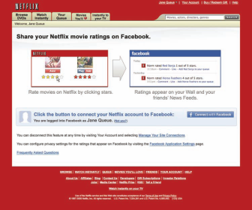
How Businesses Use Social Networks, Such as Facebook, MySpace, Twitter, and LinkedIn
Brainstorm and enhance teamwork.
Boost brand image.
Provide a forum for collaboration.
Help recruiters find talent.
Big companies rule on Facebook

Slide 29

Tips for Using Social Networking Sites and Keeping Your Job
Observe company rules, if they exist.
Remember that privacy is a MYTH.
Realize that refusing “friend” requests could jeopardize professional relationships.
Don’t share information you wouldn’t share openly in the office.
Keep your profiles free of risqué photos, profanity, and negative comments.

Slide 30

What Is Really Simple Syndication (RSS)?
Is a data file format capable of transmitting changing Web content
Allows businesspeople to monitor many news sources in one convenient online location
Increases traffic to syndicated Web sites

Slide 31
How Does RSS Work?
Content provider updates or creates new material on syndicated Web site.
Content provider transmits RSS documents (called feeds or channels) to subscribers.
Subscribers read RSS feeds with Internet browsers, e-mail programs, or “cloud” reader programs.

Slide 32
Social Bookmarking Sites
Help users search, organize, manage, and store bookmarks on the Web with the help of metadata – that is, information tags or keywords
Are aggregators, which means that they compile and list current, popular news items that will most likely to appeal to their readers

Slide 33
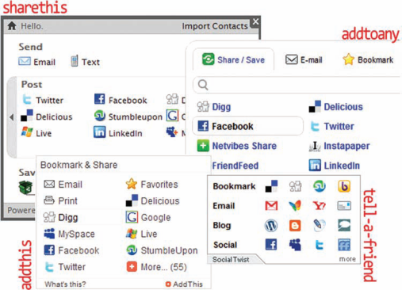
Social Bookmarking Sites
Common configurations of bookmarking icons (also known as Share links or widgets) that Web designers insert into Web pages to allow visitors to share content
By John S. Donnellan
On most high-traffic Web sites, you will see Share links, or widgets, that will take you to social bookmarking sites.

Slide 34
END

